Slide 1
Writing about literature october 2019 Library Research package
Joan Dalton
Liaison Librarian – English
jdalton@uwindsor.ca or ext. 3212

Slide 2
Agenda
Overview - Library tools, databases and reference works
Explore & explain – digital search skills
Hands-on workshop with examples (305W) – Wed Oct 30th

Slide 3
assignment
* Select a single work – poem or short story
* Use MLA database – 2 articles or chapters – analysis of your chosen work
* Reference Works, Databases – 1 article, chapter directly related to the work
* Reference Works, Databases - 1 article or chapter indirectly related to the work

Slide 4
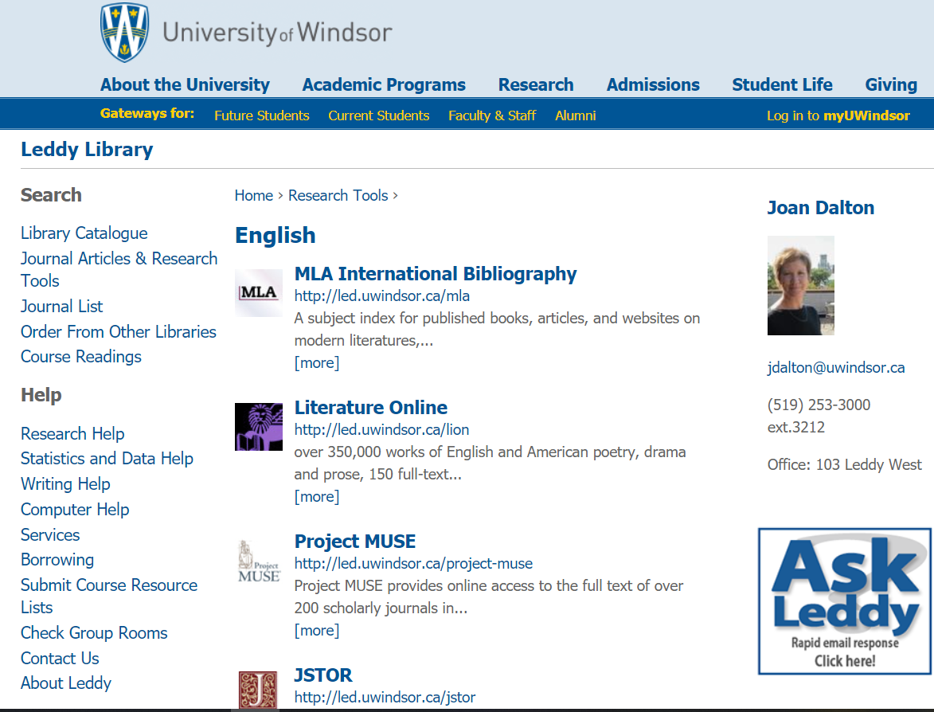
http://leddy.uwindsor.ca/english

Slide 5
Search with awareness
Why is searching a library database
different than searching Google?

Slide 6
Search with awareness
SCOPE -- What is it?
SOURCE -- Is it reliable, authoritative?
PURPOSE – When and why would I use it?

Slide 7
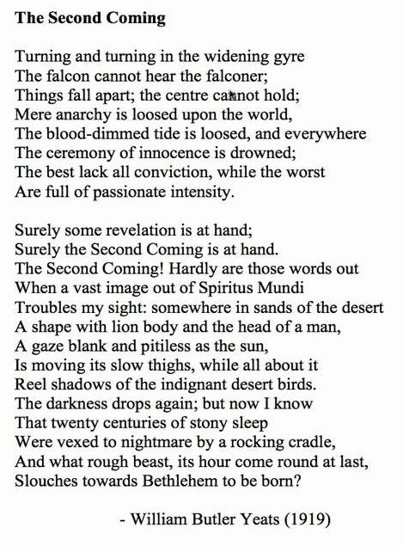
W.B. Yeats,
The Second Coming

Slide 8
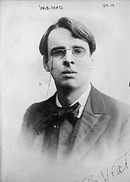
What do you know about
William Butler Yeats
1865-1939

Slide 9
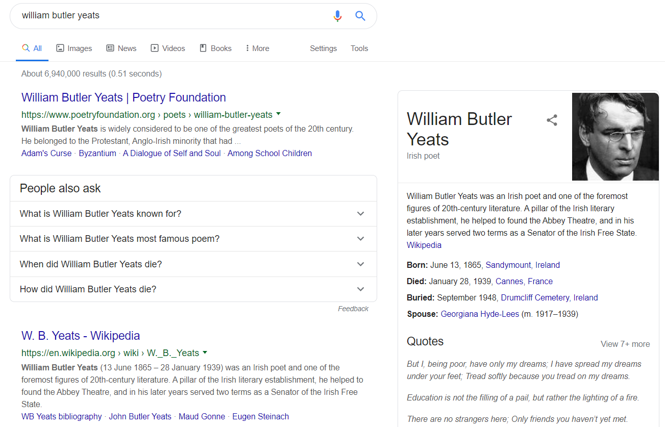

Slide 10
Database records (common fields of information = metadata)
AUTHOR
ARTICLE TITLE (CHAPTER TITLE)
JOURNAL TITLE (BOOK TITLE)
ABSTRACT
DATE
SUBJECT HEADING

Slide 11
http://leddy.uwindsor.ca/english

Slide 12
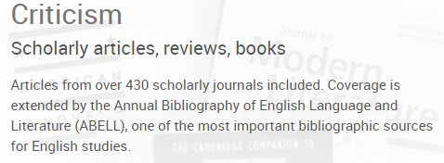
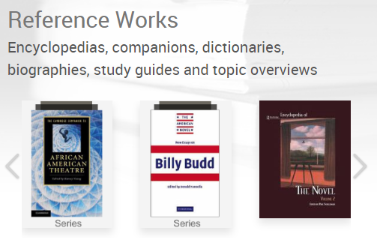
Literature Online

Slide 14
http://leddy.uwindsor.ca/english

Slide 16
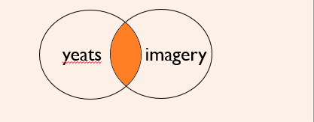
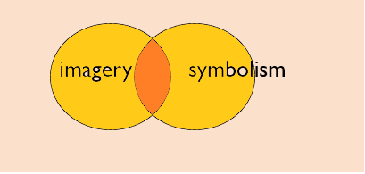
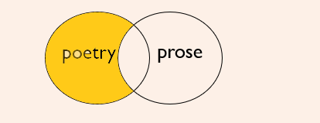
Database Searching using BOOLEAN Operators
CONCEPT | EXAMPLES | RESULTS
AND Narrows the search: results will include both terms | Yeats AND imagery
OR Broadens the search: results will include one or both terms | imagery OR symbolism
NOT Narrows search specifically: results will not include the second term | poetry NOT prose
yeats
imagery
imagery
symbolism
poetry
prose

Slide 17
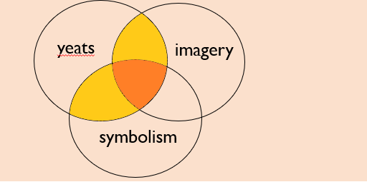
Database Searching using BOOLEAN operators
Yeats AND (imagery OR symbolism)
PHRASE SEARCHING
Yeats AND “animal imagery” “animal imagery” AND “The Second Coming”
symbolism

