Slide 1
Leddy library
Managing Employees 78-613
Fall 2015

Slide 2
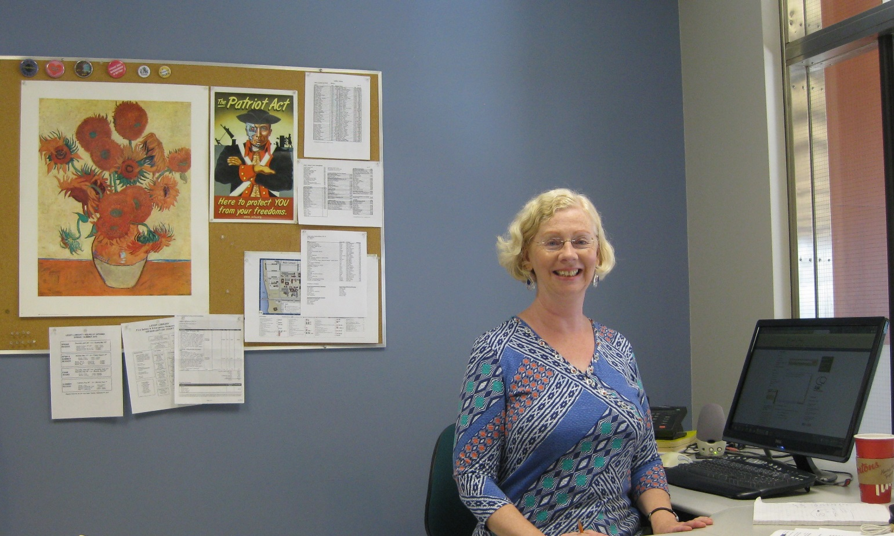
Hi! My name is Katharine. I am the Business Librarian at Leddy.
If you need help with business research
while you are here at the University of Windsor,
I am the person to contact.

Slide 3
My Contact Information:
Katharine Ball
Business Librarian
Leddy Library
Office Location: Leddy West Building, 2nd Floor, Room 214B
Email: kball@uwindsor.ca
Telephone: (519) 253-3000 ext. 3852

Slide 4
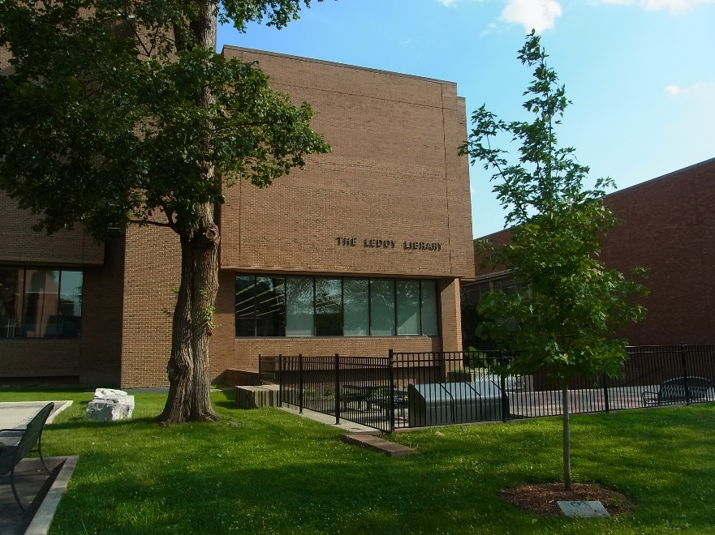
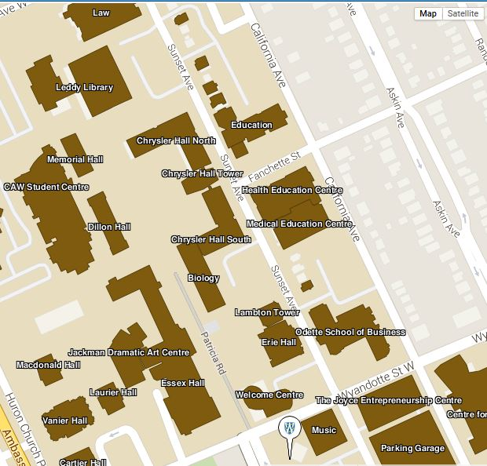
Location Of Library
Odette Building

Slide 5
Your Group Project
Students will form groups of five to six, and each group will select a company on which to do a case analysis. You will use OB theories/frameworks to analyze organizational behavior issues the company is currently facing; you will then provide recommendations on how to address these issues.
You are required to produce a case analysis report (5 single-spaced pages) and give an in-class presentation (15 minutes).

Slide 6
My Goal Today
I want to get you started on the group project, show you how to find the information you need, and give you the confidence and skills to produce a really good report and presentation ☺
BRAVO!!!

Slide 7
Selecting A Company
If you can, choose a company based on your own work experience, or that of a family member or group member.
What do you do if your group cannot come up with an appropriate company this way?
Focus on larger, publically traded companies. They are legally required to publish more information, tend to be followed by investment analysts, and are generally more concerned with the media and public perception. This means it is also easier to find relevant news stories and articles in the business and newspaper databases.
Even so, finding “inside” information on human resource problems can be difficult!
Here is one possible strategy:

Slide 8
Selecting A Company Continued…
Use a job/company review site such as Glassdoor:
https://www.glassdoor.com or https://www.glassdoor.ca
Go to Companies & Reviews.
Here you can read what employees and former employees think about a company. The reviews should help you identify possible human resource problems. You need to sign in using either your Google account or Facebook.
If you need help in narrowing down your choices, there are articles that have analyzed the Glassdoor data and arrived at a shortlist, e.g. The worst [U.S.] companies to work for: 2015 (24/7 Wall St.)

Slide 9
Selecting A Company Continued…
Another similar job/review site is Indeed: http://indeed.com/cmp or http://ca.indeed.com/cmp
If you were interested in a government organization, e.g. the Canada Border Services Agency, you can sometimes find employee surveys conducted either by the government itself or by unions. In this case, there is the 2014 Public Service Employee Survey: http://www.tbs-sct.gc.ca/psm-fpfm/modernizing-modernisation/pses-saff/index-eng.asp These surveys will give you insight into potential ob/hr problems.

Slide 10
Once you Have Identified the OB Issues That Need to be Addressed, You Will Want to Look For Additional Information To Support Your Analysis
Your textbook will probably give you enough information on the theoretical ob/hr frameworks and concepts. However, you might want to find out, for example, what other similar companies have done to resolve the problems you have identified.
This information may be contained in sources such as books, journal and trade magazine articles, blogs, research-oriented websites.

Slide 11
Leddy Library Home Page http://leddy.uwindsor.ca
Find books in the Library Catalogue
Find articles in the Business Databases: Click here and select Business Administration
For help with writing and APA style

Slide 12
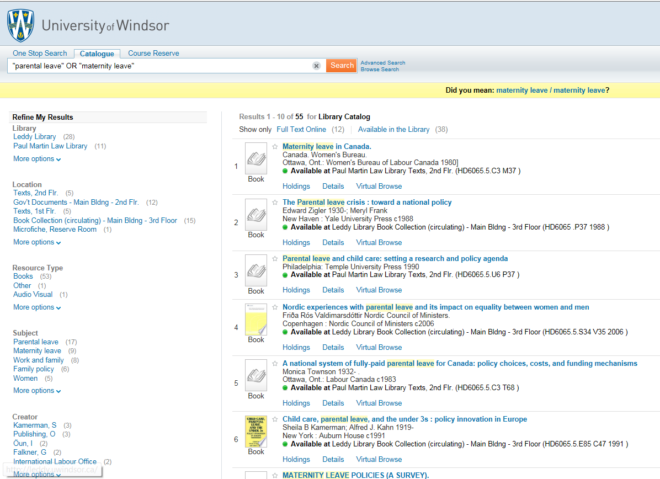
Look For Books
Use the Library Catalogue to search for books. Books tend to give a fairly broad overview of your subject, as well as history, cases, examples, and perhaps potential applications or solutions.
Examples: motivation AND work*
work-life balance
“maternity leave” OR “parental leave”
telecommuting OR telework*

Slide 13
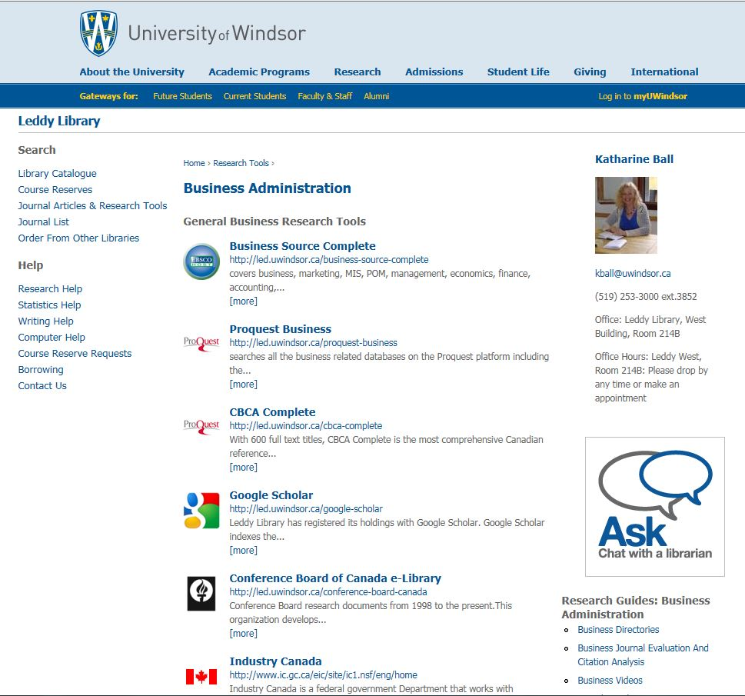
Look for Articles in the Business Databases
Business Administration Page
http://leddy.uwindsor.ca/business-administration
If you need help, contact me!
Databases
Research Guides and Course Handouts

Slide 14
Accessing The Business Databases
On campus, you do not need to sign on to the databases. However, off-campus you are required to authenticate using your University of Windsor ID and email password.
If you have problems with off-campus access, then help is available. See: Report A Problem (http://leddy.uwindsor.ca/report-problem)
It is advisable to access the databases through the Library’s website. This will ensure that the links to the full-text of the articles are present and working – which is what you want!

Slide 15
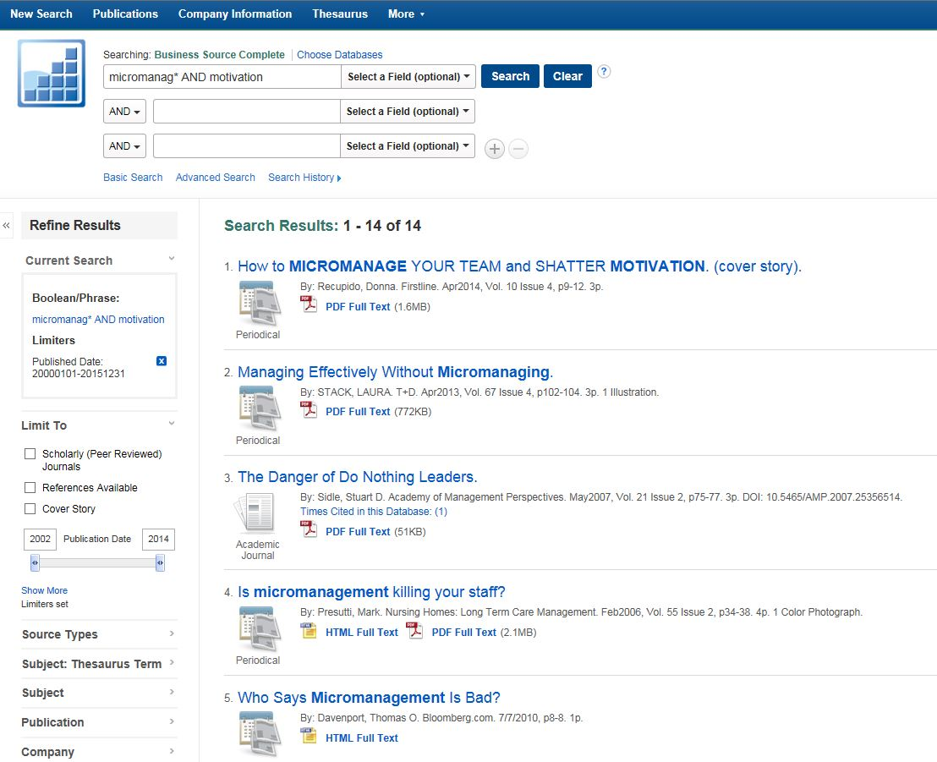
Look For Journal Articles
Search Library Databases, e.g. Business Source Complete, ProQuest Business, PsycInfo, and Google Scholar for articles on your company, and more focused research on ob/hr theory or practice.
Examples: Air Canada
micromanag* AND motivation
wellness programs
From Business Source Complete:
Refine your search here

Slide 16
Try to identify related concepts and keywords to use when doing your research
For “telecommuting”, what are some examples?
telework working from home home labor home office
So we could perhaps search:
(telecommut* OR telework* OR working from home) AND satisfaction

Slide 17
Find Additional Information on the Web
Remember to evaluate the information you use. Who is the author/publisher? What is the purpose of the website? What are its biases? How current is the information?
You might want to look at your company’s website:
E.g. Canadian Tire
Find headings such as “About Us” or “Investors”
You might want to check out what some of the “best” companies are doing:
E.g. (fortune OR forbes) AND best companies 2015
You might want to find ideas/potential hr solutions in a specific economic sector:
E.g. retail AND best practices AND (hr OR ob)
Perhaps use site:edu to narrow your search to U.S. educational institutions

Slide 18
What If Leddy Doesn’t Have the Book, Report, or Article I am Looking For?
You have a few options:
Interlibrary Loans
You can order books and articles, usually free-of-charge. It takes anywhere from a few days to much longer, depending on format and where the material is coming from.
Contact me: Katharine Ball at (519) 253-3000, ext. 3852
I may be able to purchase the book or report for the Library, especially if it is recent. Forget the super expensive market research reports!
Otherwise, I may be able to help you find other relevant information.
Borrowing From Other University Libraries
If you spend time near another Canadian University, this might be an option for you.

Slide 19
Still Feeling Unsure About How to Conduct the Analysis and Write the Report?
If you do a Google search: “case analysis” AND report – you can find guidelines and tips from a number of universities.
There are also a couple of books on Course Reserve at the Library’s Circulation Desk:
Learning with cases / Mauffette-Leenders (HF 1111 .M38 2007)
The case study handbook : how to read, discuss, and write persuasively about cases / Ellet (HD 30.4 .E435 2007)

Slide 20
How About The Presentation?
If you do a Google search: “giving presentations” - you can find guidelines and tips from a number of universities and other organizations.
There are also books in the Library, for example:
Giving presentations: expert solutions to everyday challenges / Harvard Business School (Leddy Book Collection: Main Building, 3rd Floor: HD5718.22 .G58 2007)

Slide 21
Writing Help
Research papers and assignments must be written in APA Style. Here is a popular online guide from Purdue University: OWL: APA Style
If you want to check your papers for plagiarism, then use Turnitin.com
If you need general help with structuring your research paper, grammar, or citation, please see Writing Help Services
Otherwise, you can always contact me: Katharine Ball at (519) 253-3000, ext. 3852

