Slide 1
Health Stats
A Quick and Dirty Overview

Slide 2
Where does data come from?
Public: governments, inter-governmental organizations like the UN and the World Bank
Censuses, Statistics Canada, U.N. Multiple Indicator Surveys
Non-profit: NGOs, charities, think tanks
International Food Policy Research Institute, Pew Research Centre
Academic: individual researchers and research collaborations
Private: media, corporations etc. collect data
Gallup and other polls are archived; non-news related private data is usually hard to obtain

Slide 3
Public vs. private: it’s the money
Publically funded institutions have a mandate to spend their money towards certain goals and are held accountable to the public
Private institutions / businesses have no such mandate and are not accountable beyond what is required by law
Most publically available data comes from public institutions and the occasional interested and persistent researcher, unless the data is being released for a promotional purpose / to meet a public demand (e.g. sports results)

Slide 4
Canada
National Statistics Agency: Statistics Canada
Collect or compile statistics on demographics, health, economics, agriculture…
Turned over collection of some health statistics (hospital based records in particular) to Canadian Institute for Health Information
Public Health Agency of Canada tracks data on threats to public health, including diseases and injuries. Has the Canadian Incidence Studies of Reported Child Abuse and Neglect
Individual government departments also may release statistics that they have collected for their own purposes – e.g. C.I.C. tracks immigration statistics
Provinces don’t have provincial statistical agencies per se, but again departments may compile and release some data
e.g. Rapid Risk Factor Surveillance System, funded by local Ontario health units, themselves funded by Ontario government

Slide 5
Statistics Canada
Currently 397 active surveys and data collection programs
Surveys designed to produce reliable estimates for varying levels of geography – for the provinces and territories, or for sub regions
Multi-stage cluster sampling and other more complex designs
Country divided into various kinds of statistical areas for different types of surveys: health regions for health surveys, economic regions for labour and economic surveys, and so on.
Data released as public use, anonymized data through Data Liberation Initiative, as summary tables through CANSIM and individual publications, and through RDCs for researchers who need the original raw data

Slide 6
Statistics Canada’s Data Collection Programs
The Census
The big non-census surveys
Labour Force Survey and Labour and Income Dynamics
General Social Survey
Community Health Survey
Consumer finance surveys …
Minor / occasional surveys and one-offs
Maternity Experiences Survey
Survey of the Work and Health of Nurses
And so on…
Administrative data collections (contributed by collecting agencies)
Police-reported Crime Statistics
Victim Services Survey
Tax data …

Slide 7
A Few Specific Surveys of Particular Interest
National Longitudinal Survey of Children and Youth
Follows groups of children over time to see how parenting and other life experiences affect them
General Social Survey
Annual, subject modules repeated at 5-year intervals: Violence Against Women module, Family Life module, Time Use, etc.
Survey of Household Spending
Annual, financial circumstances and expenditures of households
Community Health Survey
Annual, questions about health behaviours, scales measuring perceived health
Health Measures Survey
Includes physical measurements and tests done on blood and urine samples
Maternity Experiences Survey
One of many “one-offs”
Longitudinal Survey of Immigrants
And so on…

Slide 8
Going local
Need to deal with varying levels of geography – rarely ideal, but sometimes adequate
For neighbourhood data, think Census
Statistics Canada collects and releases health data by Health Region and by Local Health Integration Unit.
The Windsor-Essex County health unit covers only Windsor and Essex county. The Erie-St. Clair LHIN covers Windsor-Essex, Chatham-Kent, and Lambton.
Getting statistics on just the city of Windsor is often difficult if not impossible, so your goal is to find the smallest available area that contains your location you are interested in and has the data you require.

Slide 9
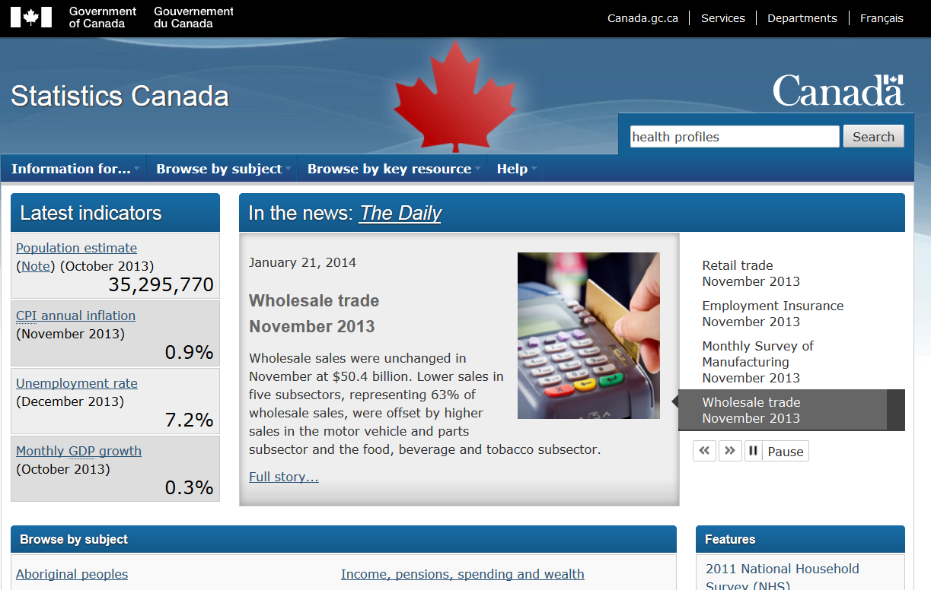
Statistics Canada

Slide 10
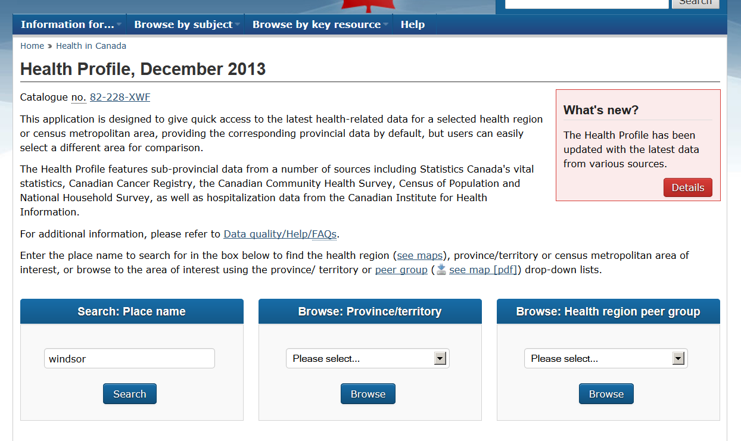

Slide 11
Go to health profile for Windsor-Essex

Slide 12
Public Health Agency of Canada

Slide 13
Go to Public Health Agency Infobase

